Slide 1



COMMUNITY SOUTHWARK
PREMISES MATCHING PROJECT

Slide 2

State of the Sector - Key Recommendations

Slide 3
Key Outcomes
Analysis of need
Audit of existing and upcoming provision
Premises matching and casework
Influence council policy and strategy – e.g. Affordable Workspace Strategy and Land Commission implementation

Slide 4
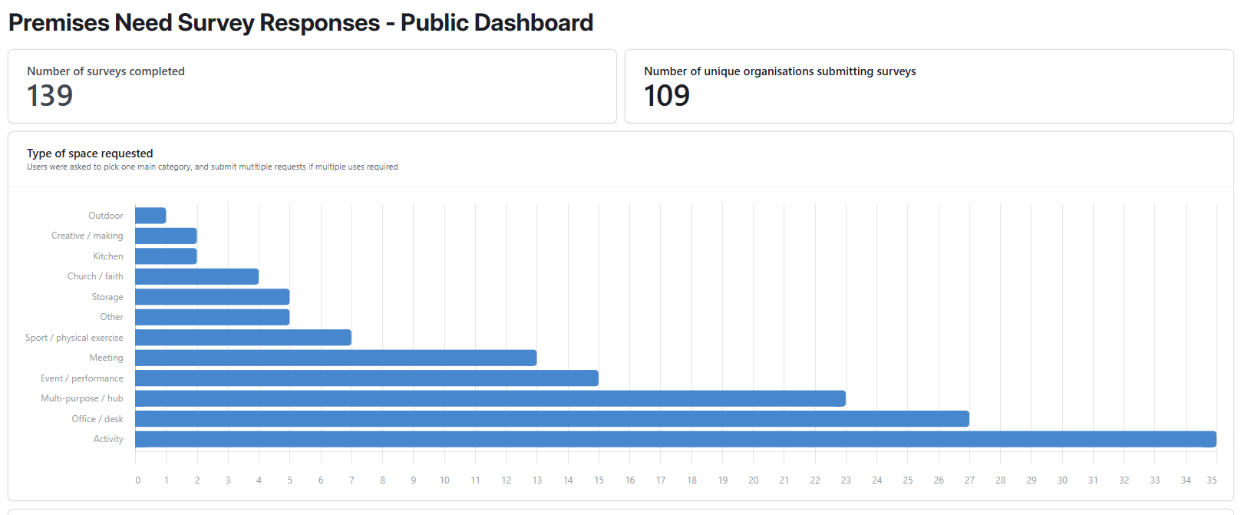
Data and dashboard
Notes:
Full dashboard available on our website: https://communitysouthwark.org/premises-project-status-page/

Slide 5
Asks to network
Promote need survey and supply survey
Consider current assets and what can be leveraged for support
  Under-used office space?
Share learning / examples of VCS space usage in your networks
Please contact alex@communitysouthwark.org

